Slide 1

Wine quality prediction
Using
Machine learning models

Slide 2
Contents
OBJECTIVE
DATA DESCRIPTION
INSIGHTS FROM EXPLORATORY DATA ANALYSIS
PROPOSED METHODOLOGY
ASSUMPTIONS
PRE-PROCESSING
MODEL DESCRIPTION
MODEL COMPARISON
CONCLUSION

Slide 3
OBJECTIVE
The aim of this project is to predict the quality of wine using machine learning models implemented in Python programming language
The proposed model is capable of predicting the quality of wine as Good or Bad, based on the parameters of the wine sample tested.
The application’s prediction will help automate the quality analysis of wine, hence making the whole process efficient, cheaper and with minimal human interaction

Slide 4
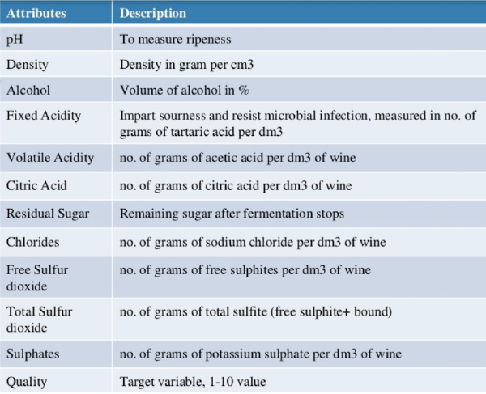
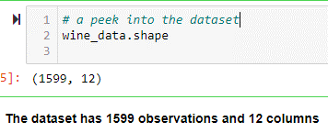
DATA DESCRIPTION
The given dataset has 1599 observations for wine
The given dataset has 12 features
11 independent features and
1 predicted feature (target variable)
Quality is the target variable

Slide 5
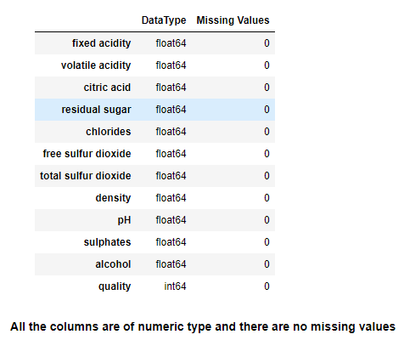
INSIGHTS FROM Exploratory DATA ANALYSIS
The given data set has no null/ missing values.
The independent variables are numeric.
The target variable (Quality) is of type integer, but is categorial.
Quality takes any value between 3-8
3 indicates wine of lowest quality
8 indicates best quality wine

Slide 6
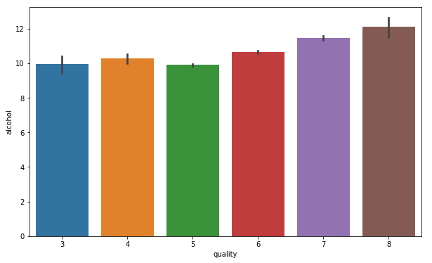
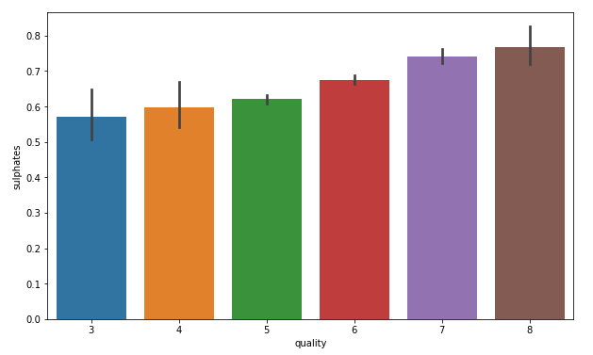
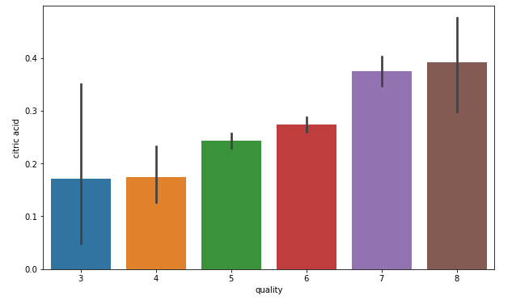
INSIGHTS FROM Exploratory DATA ANALYSIS
‘Alcohol’ and ‘Sulphates’ and Citric Acid’ have a positive impact on the quality of wine

Slide 7
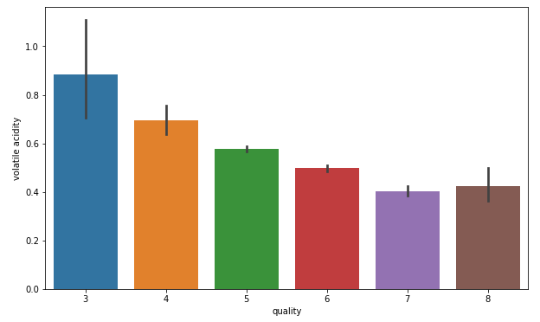
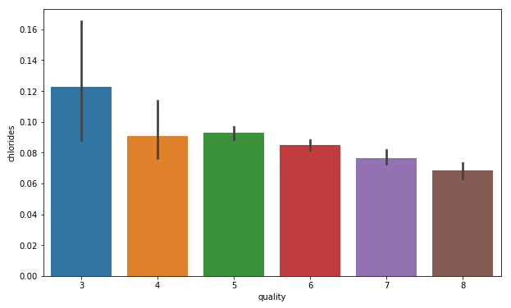
INSIGHTS FROM Exploratory DATA ANALYSIS
‘Volatile Acidity’ and ‘Chlorides’ decreases with increase in quality of wine

Slide 8
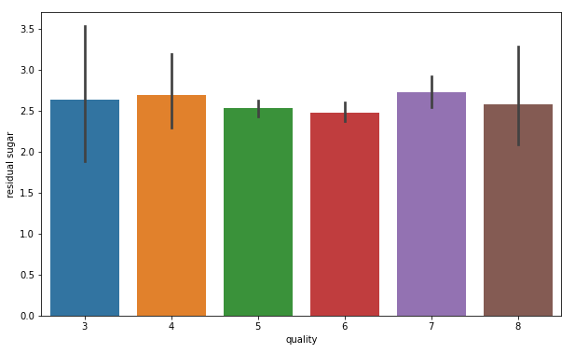
INSIGHTS FROM Exploratory DATA ANALYSIS
‘residual sugar’ is almost same across wine of different quality

Slide 9
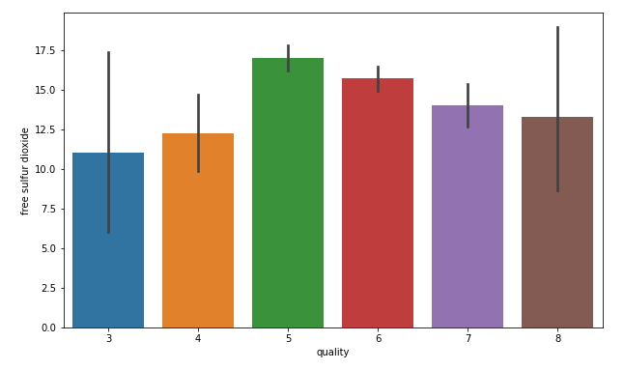
INSIGHTS FROM Exploratory DATA ANALYSIS
Relationship between ‘free sulfur dioxide’ and ‘quality’ of wine

Slide 10
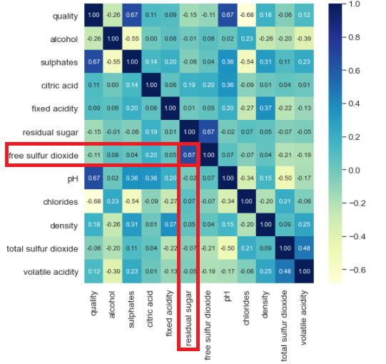
INSIGHTS FROM Exploratory DATA ANALYSIS
Correlation - a measure of the strength of relationship between variables
Fairly high correlation between ‘residual sugar’ and ‘free sulfur dioxide’ (~67%)

Slide 11
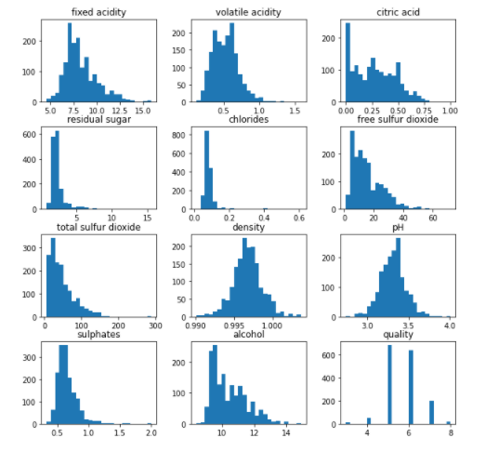
INSIGHTS FROM Exploratory DATA ANALYSIS
Outliers
In general, the histogram distribution of the features is right skewed
Indicates the presence of outliers

Slide 12
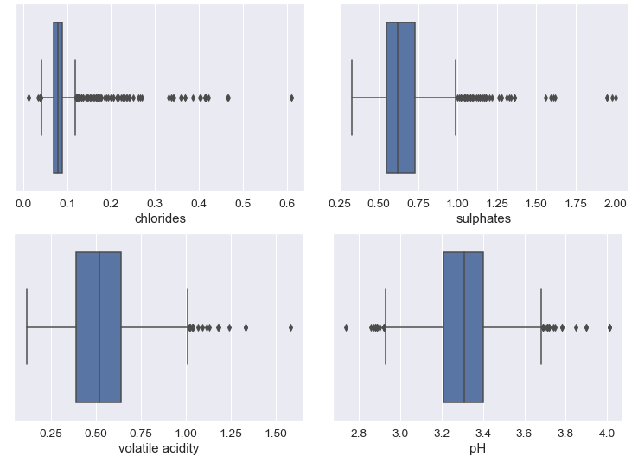
INSIGHTS FROM Exploratory DATA ANALYSIS
Outliers

Slide 13
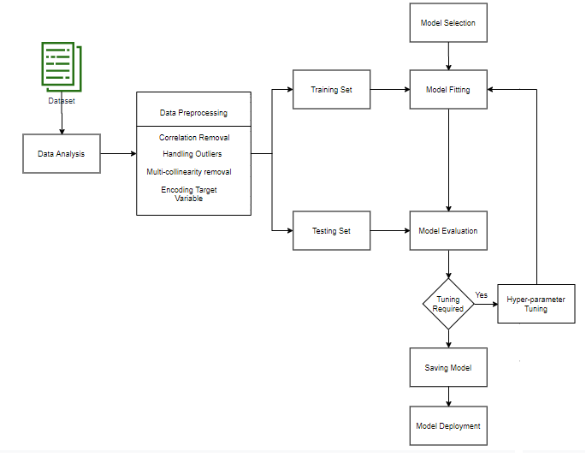
Proposed METHODOLOGY
In our approach we have used the following machine learning models:
Decision Tree
Random Forest
Logistic Regression
K – Nearest Neighbour

Slide 14
Assumptions
In the given dataset, the target variable Quality takes multiple values ranging from 3 to 8
3 indicates wine of lowest quality
8 indicates wine of highest quality
In our approach we are classifying the wine as Good – Bad
Assumptions:
Wine of quality 7,8 are marked as Good
Wine of quality 3,4,5,6 are marked as Bad

Slide 15
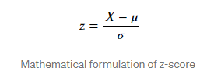
Pre-Processing
Removal of Highly Correlated Variables
Fairly high correlation between ‘residual sugar’ and ‘free sulfur dioxide’ (~67%)
The quantity of ‘residual sugar’ is statistically same across wine of different qualities
The quantity of ‘free sulfur dioxide’ varies across different qualities of wine
Hence we eliminate the ‘residual sugar’ from our data set
Removal of Outliers
The given data set has many outliers
Z-score method is used to detect outliers in the given dataset
Z-score represents how many standard deviations a data point is away from mean
Data points farther than 3 standard deviations away from mean are considered outliers
Hence we have eliminated data points having an absolute value of Z-score > 3

Slide 16
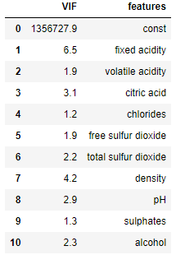
Pre-Processing
Removal of Multi-collinearity
Multicollinearity occurs when there are two or more independent variables in a regression model which have a high correlation among themselves
When the features are highly collinear, it becomes difficult to determine their individual effect on the target variable
VIF (Variance Inflation Factor) method is used to check for multicollinearity between variables
In our approach, we have decided to eliminate those variables with significantly high VIF (> 10)
None of the variables have VIF > 10, hence we have not eliminated any variable

Slide 17
Pre-Processing
Creating a new target variable ‘ wine rating’
The given dataset has target variable, ‘quality’ having values 3-8.
3 indicates lowest quality and 8 indicates highest quality
As per our assumption
“quality” 7,8 indicate wine of “Good” quality
“quality” 3,4,5,6 indicate wine of “Bad” quality
We have added a new variable “wine rating” as the target variable
For “quality” having values 7,8, the value of “wine rating” is 1
For “quality” having values 3,4,5,6 the value of “wine rating” is 0

Slide 18
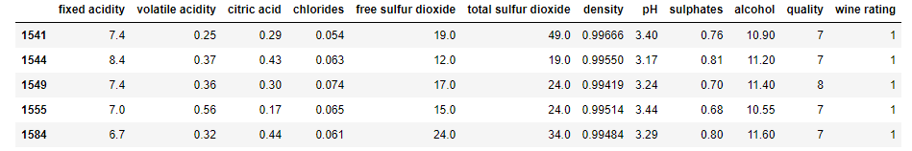
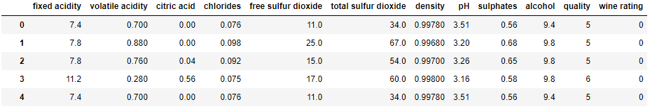
Pre-Processing
Creating a new target variable ‘ wine rating’

Slide 19
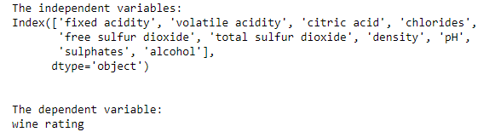
Pre-Processing
Splitting the dataset into Independent Variables and Target Variable

Slide 20
Pre-Processing
Splitting the dataset into Training Set and Testing Set
The train test split we have used is 80-20
80% of dataset is used for Training
20% of dataset is kept as unseen data for evaluating our models

Slide 21

Pre-Processing
Standardizing the Training and Testing datasets
Standardization - transforming the data so that its distribution will have mean of 0 and standard deviation of 1
Required in order to equalize the scale of the different features so that bias is reduced
We have used StandardScaler of sklearn library to perform standardization

Slide 22
Model description
Decision Tree Classifier – Classification and Regression Tree (CART)
Decision Tree is a classification algorithm that splits the sample into two homogenous sets based on significant splitter
Hyper parameter tuning was done using Grid Search CV.
The decision algorithm chosen based on the suggestion of GridSearchCV is CART
CART uses Gini impurity as the splitting criteria

Slide 23
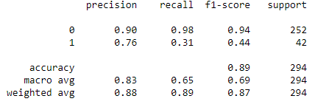
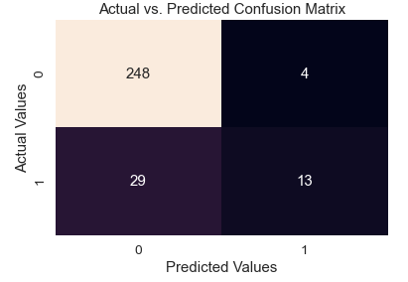
Model description
Decision Tree Classifier – Evaluation

Slide 24
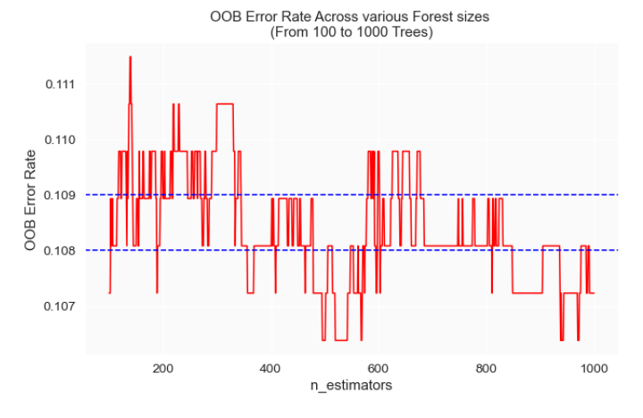
Model description
Random Forest Classifier
ensemble learning method that builds multiple decision trees
gets a prediction based on what the majority of decision trees predict
Hyper parameter tuning was performed using Grid Search CV
Using OOB error rate, the optimal number of trees (n-estimators) was found to be 400

Slide 25
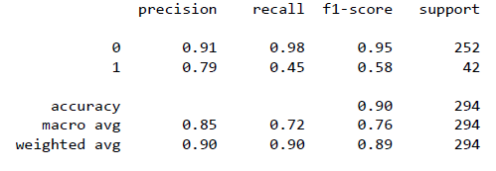
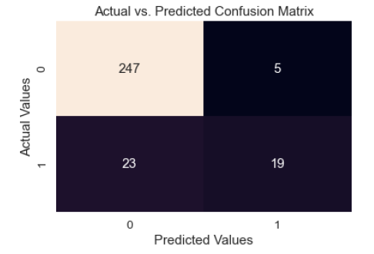
Model description
Random Forest Classifier – Evaluation

Slide 26
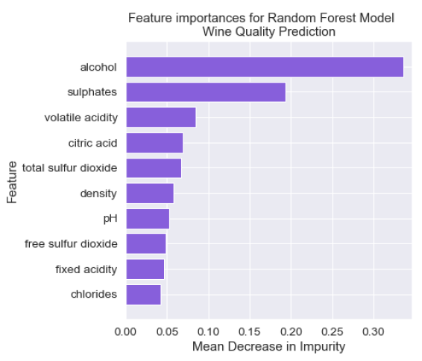
Model description
Feature Importance in Random Forest Classifier
Figure shows the feature importance for wine quality prediction using Random Forest model
Top three features which determine quality:
Alcohol
Sulphates
Volatile Acidity

Slide 27
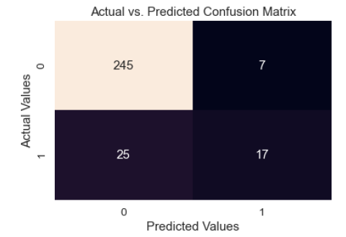
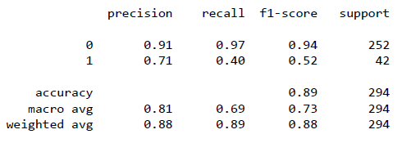
Model description
Logistic Regression
Logistic Regression predicts the probability of an outcome that can only have two values (dichotomy)
Produces a logistic curve, which is limited to values between 0 and 1

Slide 28
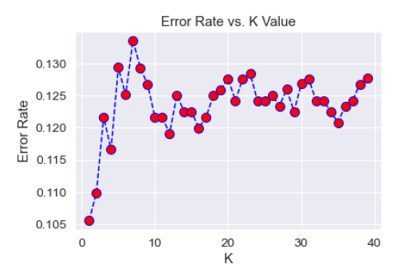
Model description
K – Nearest Neighbor
Algorithm takes a data point and selects K number of observations in the training data which are the nearest to the data point
Predicts the class of the data point based on the most popular response value from the K-nearest neighbors
The optimal value of K found during hyper parameter tuning was 21

Slide 29
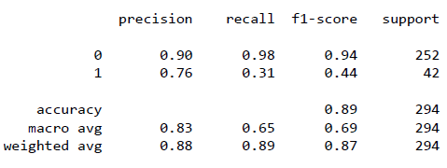
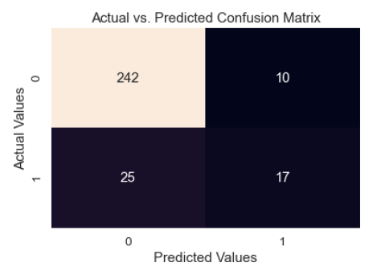
Model description
K Nearest Neighbor - Evaluation

Slide 30
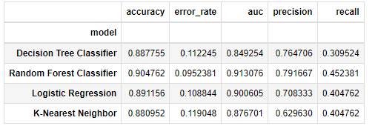
Model COMPARISION
The highest accuracy is given by Random Forest Classifier
The accuracy of the Random Forest model is 90.4%

Slide 31
CONCLUSION
In terms of model accuracy, the best model for predicting wine quality (as Good and Bad) is Random Forest Classifier
Random Forest Classifier has an accuracy of 90.4%
The top three parameters which determine the quality of wine are
Alcohol,
Sulphates
Volatile Acidity

Slide 32
Thank YOU

